Slide 1
AI-Enabled Cyber Incident Safety Web Portal
A smart web platform to report and manage cyber incidents using Artificial Intelligence for analyzing and classifying cyber complaints. Developed using modern web technologies and machine learning to help organizations respond quickly to cyber threats.
AIM -12
Guide: K.Sireesha
B.Kiran Meghana-22BQ1A6105
Sk.Sheema Sadat-22BQ1A6144
D.Anand-22BQ1A6114
K.Akash-22BQ1A6119

Slide 2
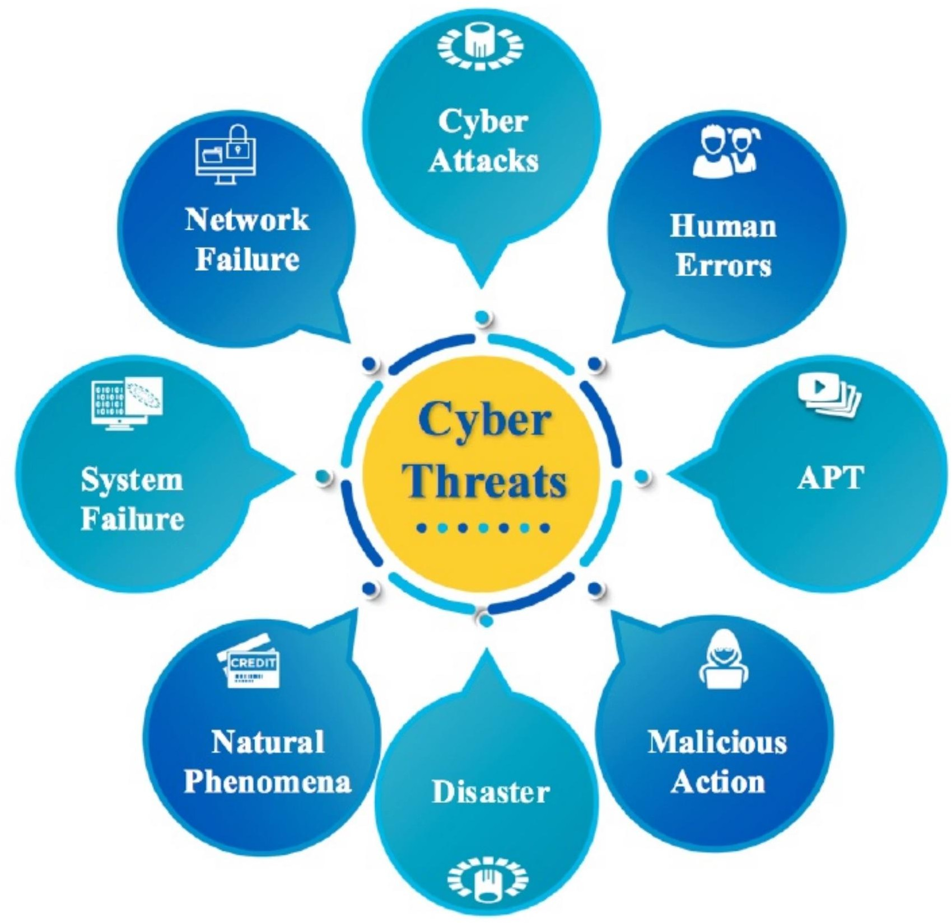
Introduction
The Digital Security Challenge
Cyber crimes are increasing rapidly in our interconnected digital world. Many incidents go unreported due to lack of accessible reporting systems, while manual analysis of cyber complaints consumes valuable time and resources.
This project addresses these challenges by providing a web portal that leverages AI to automatically analyze and categorize incidents, enabling organizations to respond quickly and efficiently to cyber threats.

Slide 3
Problem Statement
Unclear Reporting Channels
Many people do not know where to report cyber incidents, leading to
unreported attacks and lost evidence.
Manual Processing
Traditional systems process complaints manually, creating bottlenecks and slowing response times significantly.
Delayed Analysis
Delays in analyzing incidents reduce response efficiency and
increase potential damage from cyber threats.
No Centralization
Lack of centralized cyber incident management systems makes it
difficult to track and analyze attack patterns.

Slide 4
Motivation
01
Escalating Threat Landscape
Increasing number of cyber attacks and online frauds targeting organizations of all sizes
03
Secure Digital Future
Importance of secure digital environments for business continuity and data protection
02
Need for Speed
Critical need for faster and smarter cyber incident management to minimize damage
04
AI-Powered Detection
AI can assist in automatic detection and classification of incidents with high accuracy

Slide 5
Project Objectives
Develop Reporting Portal
Build a user-friendly web portal to report cyber incidents with intuitive interface and secure authentication
AI Categorization
Automatically categorize incidents using AI techniques and machine learning algorithms
Secure Data Management
Store and manage incident data securely with encryption and access control mechanisms
Admin Dashboard
Provide comprehensive dashboard and reports for administrators
to monitor and analyze incidents
Improve Response Time
Reduce response time for cyber threats through automated
analysis and prioritization

Slide 6
System Methodology
User Registration & Login
User registers and logs into the secure portal with authentication credentials
Incident Submission
User submits cyber incident details through an intuitive web form with structured fields
Data Processing
System processes and stores the incident data securely in the database
AI Analysis
AI model analyzes the incident and classifies its type using machine learning algorithms
Admin Dashboard
Admin dashboard displays reports, statistics, and analytics for incident monitoring

Slide 7
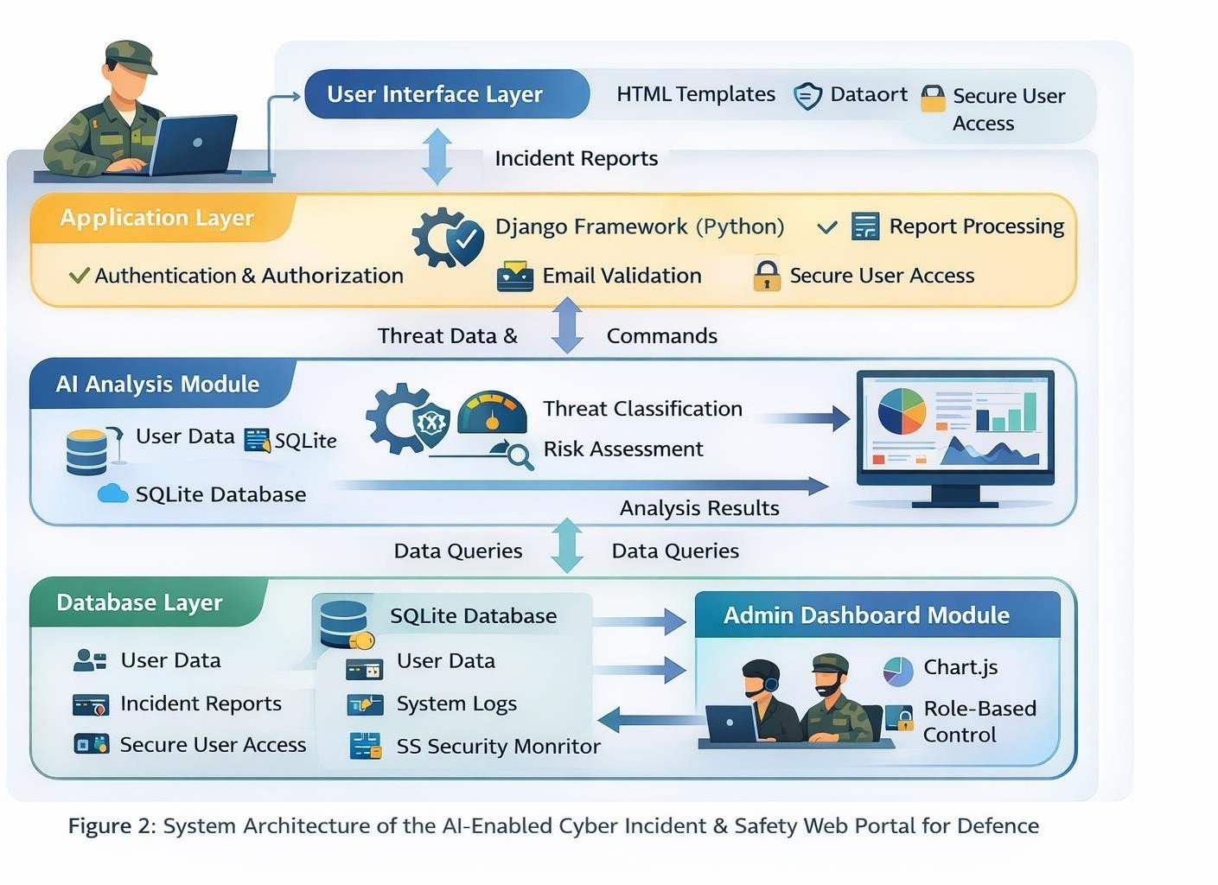
System Architecture

Slide 8
Technology Stack
Frontend
Backend
Machine Learning
HTML for structure
CSS for styling
JavaScript for interactivity
Python programming language
Django Framework for web development
Scikit-learn library
Pandas for data manipulation
NumPy for numerical computing
Database
Tools
SQLite
Structured data storage
VS Code editor
GitHub for version control
Chart.js for visualizations

Slide 9
Key Features & Results
Key Features
Online Cyber Incident Reporting
Accessible web portal for submitting incidents from anywhere
AI-Based Classification
Intelligent system automatically categorizes incident types
Secure Data Storage
Encrypted database with role-based access control
Admin Analytics
Dashboard with real-time reports and statistics
User Authentication
Secure login system with session management
Results Achieved
Faster classification: AI reduces analysis time from hours to seconds
Centralized reporting: Easy and unified incident reporting system
Enhanced monitoring: Better tracking and analysis of cyber threats
Improved response: Reduced time to detect and respond to incidents

Slide 10
Conclusion & Future Scope
Conclusion
Intelligent System
Provides an intelligent cyber incident reporting system using AI and machine learning
Future Scope
Government Integration
Integration with government cybercrime portals for unified national
response
Real-Time Detection
Real-time cyber threat detection and immediate alert notifications
Automation
AI automates classification and analysis of cyber complaints with high accuracy
Mobile Application
Mobile application development for reporting incidents on-the-go
Efficiency
Improves efficiency in handling cyber security incidents and reduces response time
Advanced AI Models
Advanced AI models for better prediction and threat intelligence

